Slide 1
Beazley
GPAS and Billing
Product Factory Rollout - Approach
May-2025

Slide 2
Scene setting
What is GPAS and Billing? Scope – Why is it important?
Describe the Mod obj get to benefits faster. Product release approach.
What do we need from you. Resource volume, role, duration.
WHERE are we today, what have we built and how can we start a product factory
Approach?
How many rationalised products we started with and how we will roll out for the bulk of the PIF and Premium – This was prioritised by volume to unlock value to the largest teams.

Slide 3

Product Delivery - Summary
Problem Statement
Modernisation is delivering a new Target Architecture to Support Growth, Scalability, Increased Controls, Efficiencies and Reduced Costs
All Beazley rationalised products (43) from 157approx to 43 need to be on new target architecture for Business to fully realise value
An end-to-end Product Delivery can only be achieved with multiple components (Workbench, Guidewire, Rating, MDA, Workday) delivered by several initiatives
Approach
A set of standard criteria's used to define Product Sequencing
Product roadmap needs to align with all initiatives
Future Product Release is dependent on all integrations and controls being delivered as part of Release 1
Delivery model needs to support parallel delivery to provide minimal disruption and provide value to Business activities
E2E delivery needs to be done at a rationalised product set
Next Product Release Inception work to start at the end of Sprint build for existing Release
Post US D&O Release, a product will require 7 months to implement e2e with the duration reducing per delivery
Product Rationalisation and HX Rating work complete before e2e Implementation
Assumptions & Dependencies
Bulk of Integrations and Dependencies built as part of D&O Release
Re-use pattern used for D&O Release
No resource dependencies from multiple teams
SMEs (Underwriting, Ops, Rating and Finance) need to be available per product, region and entity
2 teams need to have their own Project resources (POs & BAs) per workstream, Policy Centre, Billing, MDA, Integrations, Testing etc

Slide 4
Platform approach
BUSA UWWB + PC +BC
Lloyds – PC and BC in the short term
BIDAC - PC and BC in the short term

Slide 5
A Product rOLL OUT lead times
Summary approach at the top of this slide. What needs to be true for the business to make this plan happen.
Timeline Dependent Upon:
Any Product post D&O Requires 7 months
Assumptions:
Pre-Requisties
Pattern A UWB does New Business and GW does Issuance, MTA, Renewal, Re-write, Reinstatement and Cancellation
D&O Release is complete capturing the base set of integrations needed
All Controls and services required to Bind a Policy is Complete
New Business, Renewal and MTA Delivered
Document Management Solution in place
Finance Downstream Legacy/Interim Integrations done
No Outstanding Design impacting e2e Process
Product Rationalisation for Selected Product is on the shelf
Assuming Migration is on-renewal and Migration Framework/Tooling in place
Swimlane includes Design , Build and Functional Test
Activity |  | Indicative Timeline * See Assumptions
 | MTH1 | MTH2 | MTH3 | MTH4 | MTH5 | MTH6 | MTH7 | MTH8
Inception / Design (All areas)
WorkBench
Rating HX
Product Rationlisation
Guidewire PC & BC
Doc Gen, Storage & Mgt
Integrations / MDA
Migration
E2e Testing
UAT
Deploy
Joint Elaboration with all Initiatives
One-off when first IPLM Product is done
Delivery of a group of Products and all transactions delivered from Prior Release/s
All products to be completed ahead of time, duration reflecting new product or new Business Req
Factory Model will ensure all products rationalised ahead of time, duration reflects for any new product
Delivery of a group of Products and all transactions delivered from Prior Release/s
One-off when first IPLM Product is done
Risk Based Testing with a level of overlap with final Build activities and re-usable test packs

Slide 6
Product rOLLOUT lead times, Activities, milestones
Ensure that the percentage is just PIF anf premium.
Activity |  | Indicative Timeline * See Assumptions
 | M1 | M2 | M3 | M4 | M5 | M6 | M7 | M8 | M9 | M10 | M11 | M11 | M12 | M13 | M14 | M15 | M16 | M17 | M18 | M19 | M20 | M21 | M22 | M23 | M24 | M25 | M26
Release 2
Release 3
Release 4
Release 5
Release 6
Release 7
Release 8
Release 9
Release 10
Release 11
Release 12
Release 13
Release 14
Release 15
64% of US Written Premiums in Modernisation Architecture
76% of US Written Premiums in Modernisation Architecture
75% of BIDAC Written Premiums in Modernisation Architecture
NACP (US Property)
Cyber US
87% of US Written Premiums in Modernisation Architecture
US Safeguard, US EPL & Fidelity & Crime (US ML)
Global Healthcare US, Healthcare Mgt Liability, Int & US MiscMed & Life Sciences
91% of US Written Premiums in Modernisation Architecture
Cyber US
London D&O, London EPL
Cyber BIDAC
93% of US & BIDAC Written Premiums in Modernisation Architecture
Targeting first IPLM Products
International FI
International ML
Environmental
BAU to deliver remaining products
HVH
Political & Terrorism
Professions
Global Treaty
Treaty
Approx 2 years to get 93% of US & BIDAC on Modernisation Architecture
37% of Products integrated into Modernisation Architecture
Assumption of 2 teams running in parallel
Delivery gets faster as re-usability increases with each release
Product Delivery Mature to allow BAU team for delivery of remaining 63% since majority of nuances will have been resolved, e2e integrations in places, mature framework instilled for delivery and system would only require minimal configuration

Slide 7
Product Delivery - Summary
To Support Written Premium Growth, focus needs to be on North America Property
To Support Efficiencies, focus needs to be on Cyber BIDAC
To Reduce Reputational and Operational risk due to Legacy Systems, Lack of Controls and Multiple touchpoints to manage Policy lifecycle, focus should be on BIDAC
 |  | Product Options
Criteria |  | 1. D&O US | 2. Cyber BIDAC | 3. Cyber US | 4. FI & ML (BIDAC) exc UK | 5. North America Property *
Buisiness Plan
Written Premium Growth (Existing) |  | Green | Amber | RED | Green | Green
Written Premium Growth (Number of Policies) |  | Amber | Green | RED | Amber | RED
Reputational Risk |  | RED | Green | Amber | Green | RED
Operational Risk |  | RED | Green | Amber | Green | RED
People Risk UW Turnover |  | RED | Amber | RED | Green | Amber
Improve Efficiency to Support Growth |  | RED | Green | RED | Green | Amber
Existing System Challenges / Pain Points |  | RED | Amber | RED | Green | Amber
Do-ability
WB Reusability |  | TBC | TBC | TBC | TBC | TBC
GW Implementation Reusability |  | Base | Amber | Amber | Amber | RED
Product Rationlisation Ready |  | Green | RED | RED | Amber | RED
Product Governance Maturity |  | Green | RED | Green | Amber | Green
Delivery Duration e2e implmentation - Indicative |  | RED | Amber | Amber | Amber | Amber
Business SMEs/Resources |  | Green | Amber | Amber | RED | RED
Beazley Project Resourcing (PO's/BA's etc) |  | Green | Amber | Amber | RED | RED
Business Design Requirements Met (Nuances) |  | Amber | RED | Amber | RED | Amber
Sponsorship Support
Underwriting |  | Amber | Amber | Amber | Green | Amber
Operations |  | Amber | Green | Green | Green | Amber
Finance |  | Amber | Green | Green | Green | Amber
Business Impact
Teams Impacted (Products used across Bus) |  | Green | Green | Green | Green | Green
User Adoption |  | Amber | Green | Green | Green | Amber

Slide 8
Appendices
May-2025

Slide 9
The Ask
What skills do we need and the effort required from these roles?
Templates for the information we require with examples, so they understand what level of detail they need to provide.
Lead times and follow up approach to ensure that we can launch the product inception with the right level of engagement, so we run at pace.
Meeting cadence, agendas, milestones for sign-off and when build can start.

Slide 10
GPAS Post D&O Release | Resource Model Detail For Product Rationalisation
Role | Responsibility | Skills Required | Type | Duration
Product Rationalisation Product Development SME | Support Product Rationalisation Data Gathering on Policy Risk Details Approve Rationalised Product | A product resource that understands the details regarding coverages, limits, deductibles, retentions, forms, endorsements Worked with developing and maintaining products | Product Development Team By Product & Region | Elapsed Time Approx 6-12 weeks 20%
Product Rationalisation Generic SME / BA | Support Product Rationalisation Data Gathering on Policy Dec Pages/Coverage Forms Approve Rationalised Product | Collect from Multiple sources all the dec pages, coverage forms for that product that is in production | Knowledge of Beazley Products and Stakeholders who understand the content By Product & Region | Elapsed Time Approx 6-12 weeks 100%
Product Rationalisation Rating SME | Support Product Rationalisation Data Gathering on Rating Approve Rationalised Product | Need to understand the important rating factors around the product Determine what is needed to be viewed with an Underwriters lens within GW | Product Mgr or SME By Product and Region | Elapsed Time Approx 6-12 weeks 20%
Product Rationalisation Wordings SME | Support Product Rationalisation Data Gathering on Wordings Approve Rationalised Product | Understand and can supply all the wordings used for the product | Product Manager or SME By Product and Region | Elapsed Time Approx 6-12 weeks 20%
Product Rationalisation Underwriting SME | Support Product Rationalisation Data Gathering on Underwriting Guidelines Approve Rationalised Product | Understanding of Underwriting Products and any nuiances for given Product | Underwriter or SME By Product & Region | Elapsed Time Approx 6-12 weeks 20%
Product Implementation SME | Approve Rationalised Product Support Requirements Capture Activities Support and Approve Low Level Design Support & Sign-Off UAT Outputs | SME with End-to-End Understanding of Management of Policy for given Product | SME By Product & Region | Elapsed Time Approx 3-6 months 100%
Product Implementation Regional SME / PO | Approve Rationalised Product Support Requirements Capture Activities Support and Approve Low Level Design Support & Sign-Off UAT Outputs | SME / PO with End-to-End Understanding of Management of Policy for a region/entity | SME / PO By Region | Elapsed Time Approx 3-6 months 100%

Slide 11
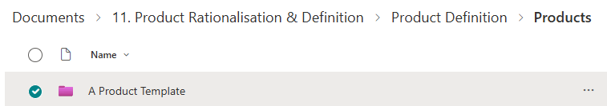
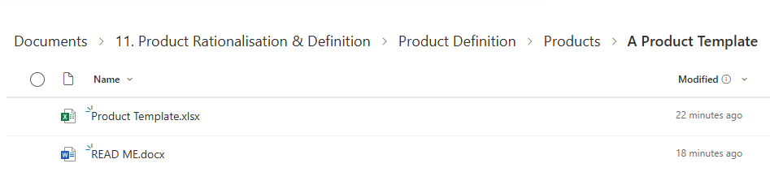
template/Folder Population (Critical) – Beazley Prep
A Product Template

Slide 12
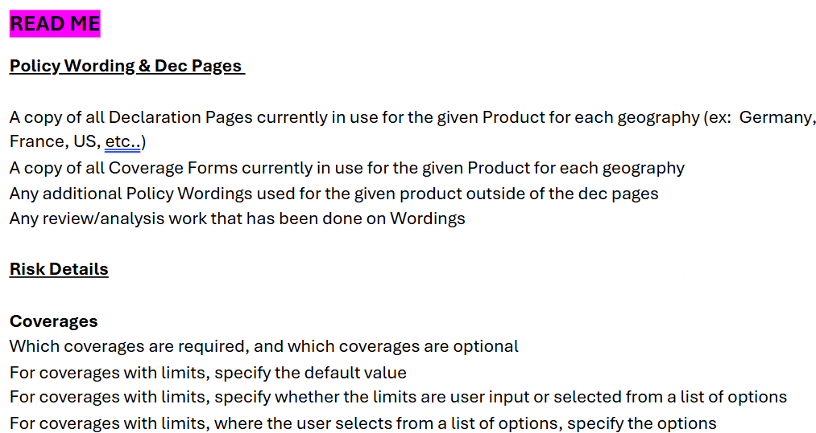
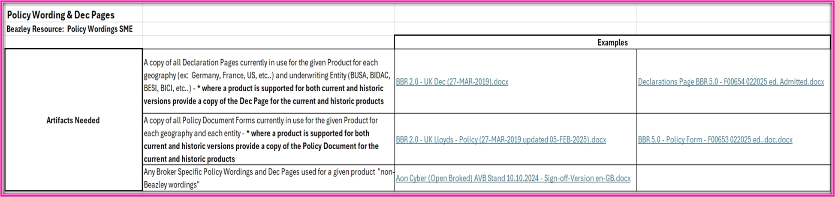
Read Me Document
Guidance for Folder Information:
The Read Me Document provides instructions on what information needs to be included in each folder. Use the Product Template to access links to high-quality examples that demonstrate what 'good' looks like.
Assignment of Information:
Each team member may have parts of the required information.
Consider the best way to assign these tasks to the most suitable individuals.
Role of the Project Manager (PM):
PM will need to coordinate efforts to ensure all necessary information is fully populated in the folders by week 1.

Slide 13
Product rationalisation lead times, Activities, milestones
* 4 weeks = maximum of 4 product offerings; 4-week deliverable = true Product Model Factory work only (Covg's, Coverage terms, Limits); Mindmap development, Import of MM into APD, Visualization & tweaks, placed on the shelf
Activity |  | Indicative Timeline * See Assumptions
 | Inception 100 days Out | MTH 1: 90 Days Out | MTH 2: 60 Days Out | MTH 3: 30 Days Out | Week 1 | Week 2 | Week 3 | Week 4 | Week 5
Inception Meetings with the Sponsors regarding buy-in/expectations Meetings with the SME’s to prep them for Data Gathering & Folder Population; PM starts setting workshop mtgs.
Data Gathering - Critical Path Policy Wordings (Beazley Generic SME) Workflow Info (Beazley Generic SME) Current PAS Info (Beazley Generic SME) Rating Info (Beazley Rating SME) UW Guidelines (Beazley UW SME) Risk Details (Beazley UW SME) *Beazley PM to manage folder population exercise; CAP to validate that data gathered aligns to what PD team needs.
Review & Understand: Capgemini Product Team to review data collection populated into Beazley Folders/Templates to prep for workshops
Conceptualisation Workshops: Interactive workshops with UW’s, Rating, Wordings, Claims, Exposure Mgmt., etc.
Mindmap Development: Capgemini iterative development as we progress through workshops
Visualisation Product Visualization in GW APD with UW’s, Rating, Wordings, Claims, Exposure Mgmt., Working Group etc.
Product Shelf Product team will put the product on the shelf for Dev to pick it up as products are sequenced and approved
Timeline Dependent Upon:
Workshop Orchestration:
The Beazley Project Manager (PM) needs to begin scheduling workshops 100 days out.
It's crucial to ensure the timing is right and the appropriate participants are lined up for the workshops.
Document Preparation:
All Beazley product information must be organized in the designated folder structure before analysis begins.
Beazley will ensure the documents are 'ready for consumption' in the provided folders.
If the documents are not 90-100% complete, it will delay the timeline.
Subject Matter Experts (SMEs): Critical Path
All Beazley SMEs must be identified before the project starts.
SMEs should have dedicated time allocated to complete their tasks.
SMEs must be empowered and agreeable to make decisions.
Decision-Making:
Decisions must be made within 24 hours.
Governance is in place for expedited signoffs, managed by the Beazley Project Owner (PO).
Beazley Prep – Folder Population
Upload MM into APD
LEGEND
Kick Off
Sign Off
On Shelf
Check point

Slide 14
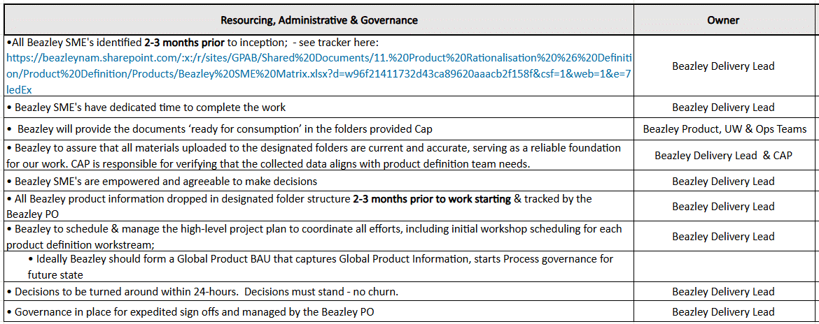
PRODUCT MODEL FACTORY ASSUMPTIONS
Implications for any/all these not being met:
Stalled or Extended Product Definition L2 timeline which can also affect downstream work

Slide 15
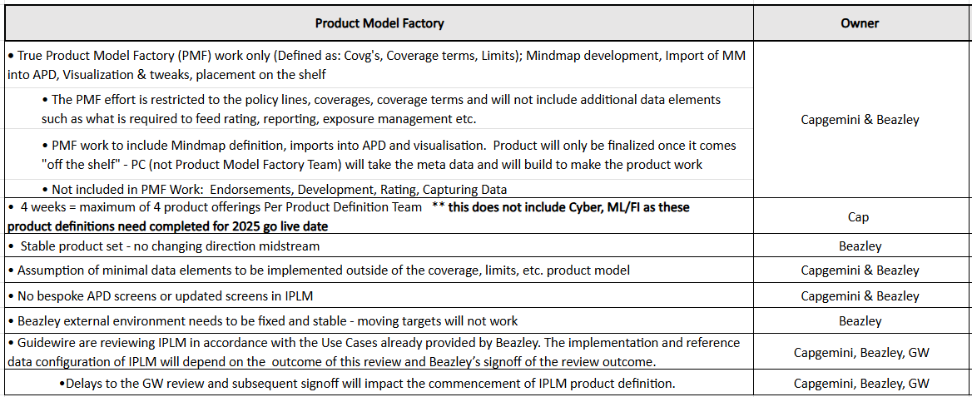
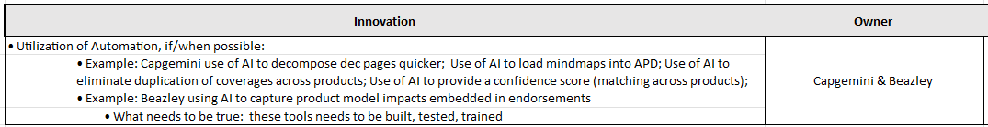
PRODUCT MODEL FACTORY ASSUMPTIONS CONT….

Slide 16
Next Product Candidate
Next product candidate
  Identify product 2 and how we will approach?
  Identify product 3 and timelines etc.
  Forecast this against Caps two squad approach and roadmap how long it will take us to deploy all products. I know this will be based on a set of assumptions Target is Q3 2027!

Slide 17
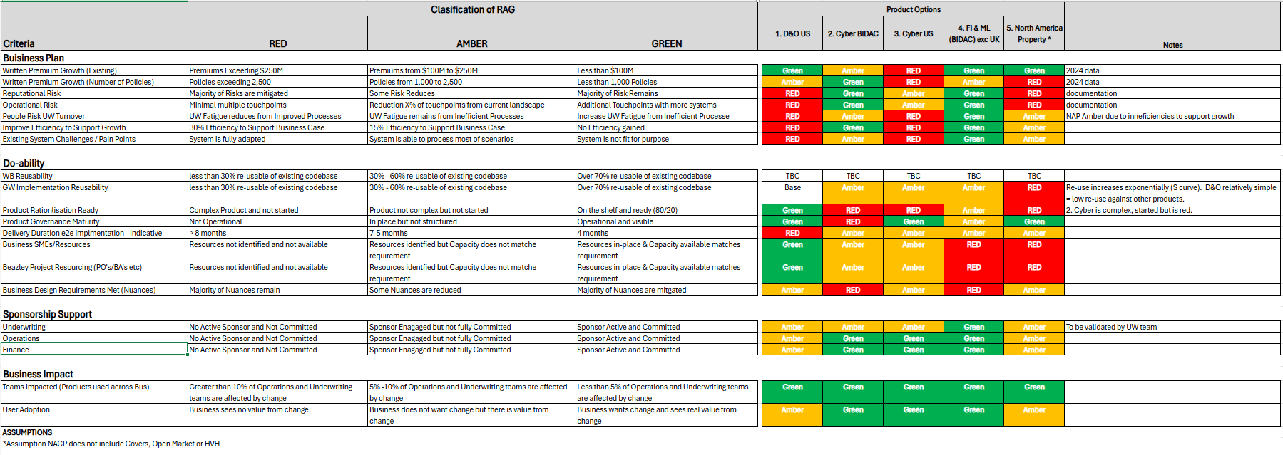
APPROACH AND ESTIMATES – Product Selection
Recommendation to Prioritise BIDAC FI & ML
  Although Written Premium Value is low, Volume of Policies is high impacting Team efficiencies
  Greater Reputational and Operational risk due to Legacy Systems, Lack of Controls and Multiple touchpoints to manage Policy lifecycle
  Do-ability is higher due to GW & Product Rationlisation re-usability (Assuming Beazley Resources are available)
  Sponsorship & User Support due to current broken processes will enable greater User Adoption
Criteria.xlsx

Slide 18
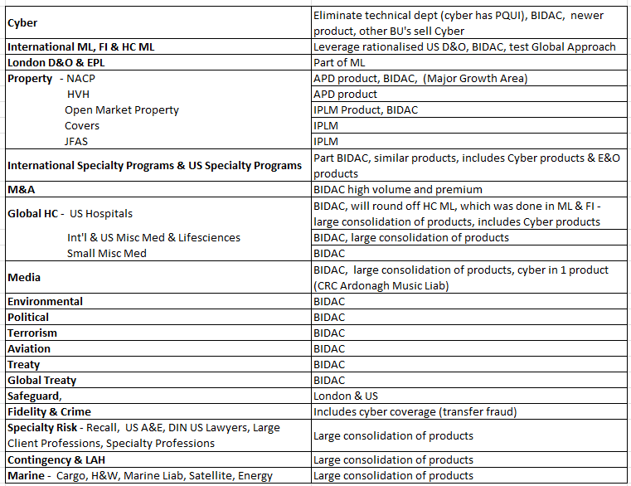
Suggested sequencing
Key Beazley Considerations
Support Reducing Operational & Reputational Risk
Greater Opportunity to Increase Efficiency for Existing Processes and Future Growth
Build on Existing GW Re-Usability and Leveraging already Product Rationalisation work Completed
Sponsorship Support from all Impacted Areas
Cyber Goal of reaching $4b asap
De-risking the BIDAC lines (high volume and premium specifically in cyber, FI, ML & M&A )
Property is a major growth area
UW WB sequencing
Key Product Definition Considerations
Common LOB's - reuse of common content (i.e. ML, FI)
Product Combinations (i.e. Cyber is used by multiple BU's)
APD v. IPLM
# of Policy Lines, Product Offerings
Complexity of how well each product is supported from a PC base perspective, and which may need more customization because we cannot use a base product (i.e. marine or surety does not have a base product)
* To be aligned with the Sequencing Criteria Spreadsheet

Slide 19
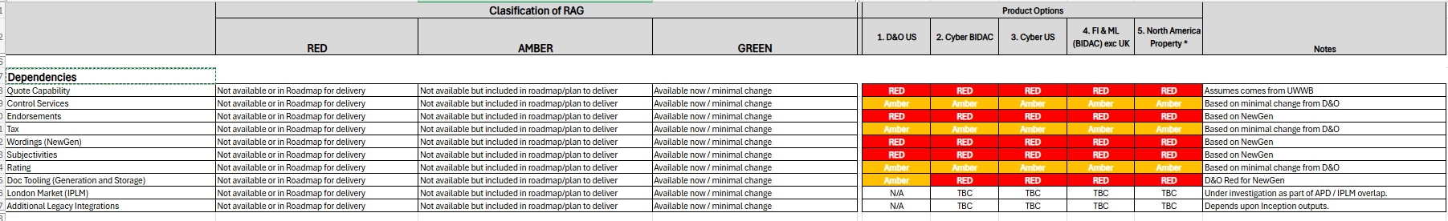
APPROACH AND ESTIMATES – Dependencies

Slide 20
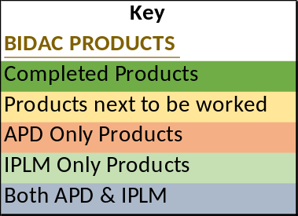
Product Model work Approach
 |  |  | APD | IPLM | Weeks | Weeks
Division | Team | Group |  |  | CAP Team 1 | CAP Team 2
Cyber Risks | Cyber | Cyber | Yes | Yes | 11
Specialty Risks | International Specialties | International ML | Yes | Yes |  | 7
 |  | Financial Institutions (FI) | Yes | Yes
 |  | International Specialty Programmes | No | Yes
 | London Market Wholesale Executive Risks | London D&O | No | Yes
 |  | London EPL | No | Yes
 |  | London Safeguard | No | Yes
 |  | US Safeguard | Yes | No |  | 4
 | LMW/US Executive Risks | US EPL | Yes | No
 |  | US D&O | Yes | No
 |  | Fidelity & Crime | Yes | Yes | 4
Property Risks | Property | HVH | Yes | No |  | 8
 |  | NACP (US Property) | Yes | No | 4
 |  | Covers (& Package) | No | Yes |  | 8
 |  | JFAS (& Swiss) | No | Yes | 4
 |  | Open Market | No | Yes |  | 4
 | Treaty | Treaty | No | Yes | 8
Specialty Risks | Global Healthcare | Healthcare Management Liability | Yes | No | 4
 |  | US Hospitals | Yes | Yes |  | 4
 |  | Int'l & US MiscMed & Life Sciences | Yes | Yes | 8
 | Specialties & US Programmes | Small Business Misc Med | Yes | Yes
 |  | Media | Yes | Yes |  | 16
 |  | Product Recall | Yed | Yes | 4
 |  | US Specialty Programmes | Yes | No | 8
 | Global PEMA | Environmental | Yes | Yes | 8
 |  | US A&E | Yes | No |  | 4
 |  | M&A | Yes | Yes |  | 4
 |  | DIN US Lawyers | No | Yes | 4
 |  | Large Client Professional | No | Yes |  | 8
 |  | Specialty Professions | Yes | Yes | 4
MAP Risks | PAC | Political | Yes | Yes | 4
 |  | Contingency | Yes | Yes |  | 16
 |  | Terrorism (& K&R) | Yes | Yes | 4
 |  | LAH | No | Yes
 | Marine | Cargo | Yes | Yes |  | 4
 |  | Hull & War | Yes | Yes | 12
 |  | Marine Liability | Yes | Yes
 |  | Satellite | No | Yes |  | 4
 |  | Aviation | Yes | Yes
 |  | Energy | No | Yes | 4
Specialty Risks | Global Treaty | Specialty Surety | No | Yes |  | 8
 |  | Specialty PT | No | Yes
 |  | Specialty BPS (Embedded) | No | Yes
 |  |  |  |  | 95 | 99
 |  | Effort = Total 194 weeks |  |  | Weeks | Weeks
4 weeks = maximum of 4 product offerings
4-week deliverable = true Product Model Factory work only (Covg's, Coverage terms, Limits); Mindmap development, Import of MM into APD, Visualization & tweaks, placed on the shelf
Will continue to rationalize products as we do the Definition work
2 Cap teams working simultaneously, 5 days a week, non-stop, no holidays, no vacations = 99 Total WEEKS (to reduce this timeframe, you would have to throw more Cap teams at this)
Team 2 needs to start out running; no time for team 1 to bring them up to speed

Slide 21
Beazley
GPAS and Billing
Delivery High Level Approach & Draft Plan
May-2025

Slide 22


Repeatable process – E2E Product Factory
Cap + Beazley
Beazley
Inputs from Product Definition factory
Dependencies readiness – Central services, InRule services, HX, UWWB, other external and internal integrations
Business Readiness
Go Live
Pattern decisions
Inception
Sprint Build & Test
Testing
Product Specific requirements + Variations of common requirements
PolicyCenter Extension Pack for Product specific common requirements
Process repeated for each Product Set, commencing soonest for each following product definition completion

Slide 23
Lessons learned
Tackling our lessons learned from D&O will help bring validity to our Revised Roadmap…
Faster decision-making with enforced governance to prevent reversal:
  Decisions to be made quickly: Accountable owner assigned to own a decision; from data capture through the production of collateral, communication of options and a recommendation, to the gathering of stakeholders, ensuring the decision gets made, recorded (under the recognised programme governance vehicle), and communicated to programme leads. For this, Architecture & Programme Leadership must get to a position of alignment quickly and definitively.
  Decisions are not reversed: If challenged, decisions are not reversed / changed, and if this is unavoidable, there is acceptance of change going through formal change control (also unavoidable).
Joined-up cross-Modernisation agreed roadmap:
  Gain alignment across senior stakeholders to a Modernisation portfolio level roadmap: Produce and publish an agreed roadmap that is grounded on the cross-Modernisation dependencies such that GPAS dependencies are prioritised sufficiently in each Modernisation programme stream (e.g. Underwriting Workbench) to support the GPAS delivery plan.
On time dependency delivery:
  Secure on time dependency delivery: In addition to 1 and 2, hold each workstream lead accountable for delivering their dependencies to match the requirement, and be on time. This requires each lead to sign up to, and then deliver to, an agreed scope and delivery date, participate in regular reviews to ensure delivery is kept on track.

Slide 24
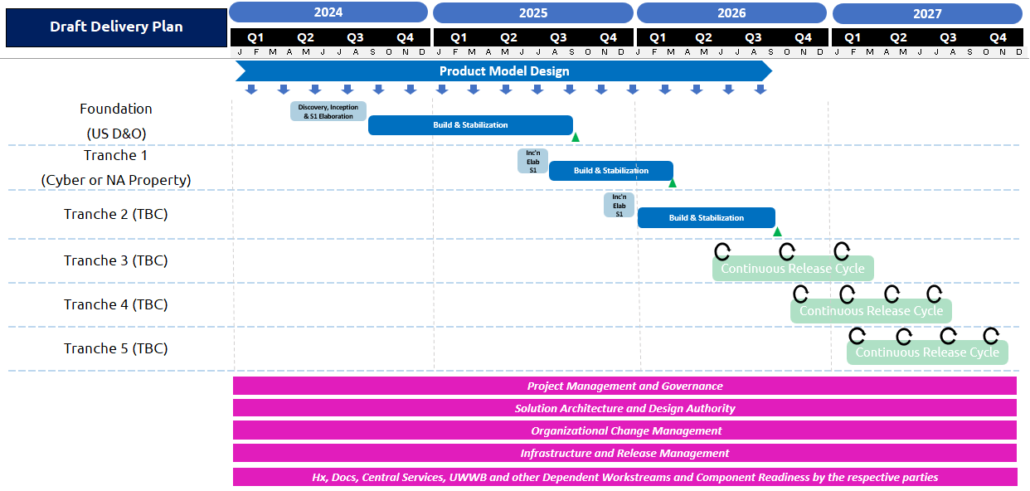
Revised ROADMAP
Business Outcomes:
Product Rationalization activity in parallel to releases.
Foundation delivery to learn early and prove business outcomes.
Quickly focusing on Cyber of NA Property to drive value.
Parallel delivery as Product Model Definition runs ahead of future tranches.
Iterative Delivery for Tranches 2,3,4, and 5 prioritised based on business value.
Note: Plan is baselined up to Foundation(Q3 2025), all remaining delivery timescales are dependent upon criteria being met (see ‘New Product Candidate’ slide)

Slide 25
Beazley
GPAS and Billing
Delivery Approach – Inception, Elaboration, Sprints & Cadence
May-2025

Slide 26


SPRINT STRUCTURE FOR A RELEASE
Focusing on execution of current sprint while doing elaboration for next sprint
A sprint is 2 weeks in duration
Each 2 weeks duration does execution of current sprint while doing elaboration for next sprint
Elaboration For Sprint 1
Development & Testing For Sprint 1
Last week has PREP meetings for SPRINT 2 ELABORATION
Elaboration For Sprint 2
Development For Sprint 2
Last week has PREP meetings for SPRINT 3 ELABORATION
Elaboration For Sprint 3
Last week has PREP meetings for SPRINT 4 ELABORATION

Slide 27
SPRINT IN ACTION ON A TIMELINE
Sp1 Elab completes
Sp2 - 2 weeks Elaboration begins
Sp1 - 2 weeks Build begins
Week-2
Day-1 | Day-2 | Day-3 | Day-4 | Day-5
Week-1 |  |  |  |  | Week-2
Day-1 | Day-2 | Day-3 | Day-4 | Day-5 | Day-1 | Day-2 | Day-3 | Day-4 | Day-5
Sprint1 preparation, validate Sprint1 DoR
Sprint1 Planning
Start Sprint1 in JIRA
Test planning, review and signoff
Test design, execution and automation
Defect triaging and retesting
Regression, demo & Reporting
Incremental Feature Demos to be planned by Beazley Product Owner across sprints, not necessarily for each sprint.
Sp3 - 2 weeks Elaboration begins
Sp4 - Elaboration start
Sp2 - 2 weeks Build starts
Sp3 - Build starts
Week-1 |  |  |  |  | Week-2
Day-1 | Day-2 | Day-3 | Day-4 | Day-5 | Day-1 | Day-2 | Day-3 | Day-4 | Day-5
Week-1
Day-1 | Day-2 | Day-3 | Day-4 | Day-5
Validate Sprint1 DoD
Sprint2 planning
Start Sprint 2 in Jira
Optimisation levers:
User story pushed to dev pipeline when ready
Show and tell as soon as the user story is ready
Early visibility into sprint closure through Jira dashboards
Jira to be used as the Single source of Truth on story development progress
Testing dashboards for real time progress on test- execution and defect trends
Validate Sprint2 DoD
Sprint3 Sprint planning
Start Sprint3 in Jira
Sprint2 Retrospective
Sprint1 Closure report
Sprint1 Retrospective
Sprint2
Closure report

Slide 28




STANDARD DEVELOPMENT TEAM COMPOSITION
Each Release Train team – Policy, Billing, Integration would consist of cross functional skill
Release Train lead/Technical lead
Developers
Testers
Partial availability of the following groups to help query resolution OR address requirement or design changes
Business Analysts (Capgemini)
Architects (Capgeminii)
Business PO or SME (Beazley)
DevOps (Beazley)
Team Roles
Product Owner
Release Train Lead/Technical Lead
BA
  Leads Team in delivering outcomes supporting
  the strategy
  Provides business analysis; supports requirements gathering
  Leads and reinforces Agile practices
SME
Dev Team
  Brings expertise to provide guidance and feedback for capability development
  ~50% allocation
  To build & test the features
Functional Leads
DevOps
Third Party
  Functional resource who provides ad hoc expertise and guidance
  To deal with build operations & environment support
  Support required from third party app/services

Slide 29

A ‘DAY IN THE LIFE’ DURING INCEPTION WORKSHOPS
Actors
Product Owner
SMEs
Solution Architect
Team members
Functional lead / BA
Inception
Accelerators / Tools
Inception
readiness
Output
Inch-deep; Mile wide
GW OOTB Feature Matrix
Decision Log, Action Item tracker
Query log
Mind map
Standards & Best Practices guide
Inception Plan
Inception session Guardrails
Right Tools – High level Backlog, Functional accelerators
Preparedness to Workshop topics
Guidewire OOTB Cloud Instance for demo
Understanding Client’s Business process at high level
As-is Process flows
Signed off Product / Release Backlog with Epic-Feature-Story mappings
Product Rationalization – definition & approach
Integration Inventory
Key Decisions, Pending Actions, Parked items Log
Future State process flows
Draft Sprint Plan
High level Designs
Architectural Decision log
Updated Dependencies Tracker
Best Practices
Focus on ‘What’ not ‘How’
Demonstrate OOTB capabilities
Leverage Workshop tools
Confine to Scope
Maximize Product Value
Think holistically (‘Big Picture’)
Bring on board all relevant Workstreams to the sessions
80:20 rule
Minimize distractions
Challenge Current Process
Be tough on Ideas, not on each other
Inception
readiness
Inception Workshops
Understand Guidewire Product Capabilities
Undergo Product Training / Product demo
Understand Ways of working, Program methodology etc
Understand Program Scope
Understanding base Architecture (e.g. Headless architecture for PolicyCenter)
Understanding UWWB Scope, capabilities and what has been built & planned
Enabling SMEs with authority to decide
Adapt Vs Adopt
1. Strategize
3. Synthesize
2. Conduct
Tasks / Ownership
Tasks / Ownership
Tasks / Ownership
Tasks / Ownership
Challenges
Architectural Solution Design
and recommendations
High level Integration Design
Data Structure & Data model
Third Party Dependencies
Context setting & Facilitate
Gather Business Requirements
Understand business need for Sys change
Demo GW Application, Process flows
Identify areas of change
Identify dependencies & impacted systems
Capture requirements;, Key decision, Actions & Parking lot items
Own and close assigned actions in time
Send Workshop minutes
Create Feature mapping to User Stories
Thinking inside of Legacy box
Trying to create Perfect Solution
Unclear Requirements
Over customization
Need Vs Want
Moderate workshops
Bring in Right participants
Make decisions quickly
Identify Owners to resolve dependencies
Own &/or Assign actions
Drive actions to closure
Ensure workshop alignment with ‘Big Picture’
Preparedness to Workshop
Active Participation
Provide Business Requirements
Elaborate Current State Process / rationale
Make decisions quickly
Own actions end to end
Close actions in time
80:20 rule
Adapt vs Adopt

Slide 30
A ‘DAY IN THE LIFE’ DURING ELABORATION WORKSHOPS
Actors
Product Owner
SMEs
Solution Architect
Team members
Functional lead / BA
Elaboration
Accelerators / Tools
Elaboration
readiness
Output
Mile-deep; Inch wide
Advanced Product Designer
Mind map
Feature matrix
Business rules, FLS & other templates
Decision Log, Action Item tracker, Query log
Guidewire Accelerators (e.g. Co-insurance)
Updated Sprint Plan
Elaboration session Guardrails
Right Tools – Signed-off Release Backlog from Inception, Functional accelerators
Preparedness to Workshop topics
Guidewire OOTB Cloud Instance for demo
Process during Implementation phase, Program Management Tools etc.
As-is Business Process flows
HL Future State Business Process flows from Inception
Playback sessions* to demonstrate Requirements captured
Signed-off User Stories including Business Rules, FLS and Acceptance criteria
Integration Inventory
Key Decisions, Pending Actions, Parked items Log
Updated Future State process flows
Low level Designs
Architectural Decision log
Updated Dependencies Tracker
Updated RAID log
User Stories handed over to Dev & Test teams
Best Practices
Maximize Product Value
Demonstrate OOTB capabilities
Use wireframes or mock-ups
Leverage Workshop tools
Storyboarding
Build incrementally
Think holistically (‘Big Picture’)
Bring on board all relevant Workstreams to the sessions
80:20 rule
One Team approach
Seamless communication
Follow Agile Ceremonies
Elaboration
readiness
Elaboration Workshops
Understand Guidewire Product Capabilities
Deep-dive into Ways of working, Program methodology for Implementation phase
Understand Release Scope
Understanding base Architecture (e.g. Headless architecture for PolicyCenter)
Understanding UWWB Scope, capabilities and what has been built & planned
Enabling SMEs with authority to decide
Adapt Vs Adopt
1. Strategize
3. Synthesize
2. Conduct
Tasks / Ownership
Tasks / Ownership
Tasks / Ownership
Tasks / Ownership
Challenges
Architectural design and decisions
Low level Designs
Integration approach
Migration Strategy
Data mart or Data lake designs
Third Party Dependencies
Other Tooling required
Facilitate & Deep-dive into Business Requirements
Understand detailed business process
Demonstrate OOTB functionality
Identify areas of system change
Identify dependencies & impacted systems
Capture requirements;, Key decision, Actions & Parking lot items
Own and close assigned actions in time
Capture workshop notes, detailed requirements & failover conditions
Scope change on signed-off requirements
Thinking inside of Legacy box
Trying to create Perfect Solution
Over customization
Procrastination & indecisive
Moderate workshops
Bring in Right participants
Make decisions quikcly
Encourage SMEs to make decisions
Identify action Owners & resolve dependencies
Own &/or Assign actions
Drive actions to closure
Ensure workshop alignment with ‘Big Picture’
Preparedness to Workshop
Active Participation
Provide detailed Business Requirements
Elaborate Current State Process / rationale
Make decisions quickly
Own actions end to end
Close actions in time
80:20 rule
Adapt vs Adopt

Slide 31
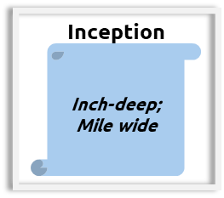
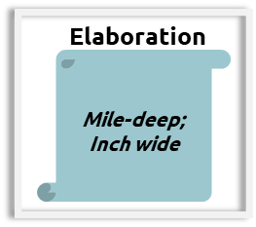
LEVEL OF REQUIREMENTS DISCUSSED DURING INCEPTION VS ELABORATION (ILLUSTRATIVE)
Inception Phase
Elaboration Phase
Ability to search for an Account using following fields:
First and Last name
Phone number
Postcode, Country and first/last name
Ability to search for an Account using the following fields:
First and Last Name – Alphanumeric field 20 bytes long
Phone number – 11 digits, no hyphens
Postcode, Country – should be able to handle outside UK location
Ability to search for an Account using following fields:
First and Last name
Phone number
Postcode, Country and first/last name
Ability to search for an Account using the following fields:
First and Last Name – Alphanumeric field 20 bytes long
Phone number – 11 digits, no hyphens
Postcode, Country – should be able to handle outside UK location
Ability to generate a unique policy number at the end of policy issuance process
Ability to generate a unique policy number at the end of policy issuance process
Policy Number must be 10 digital alphanumeric field
Prefix with 2 letter Country code ( E.g. – GB for United Kingdom)
Format Must be 2 letter Country code, followed by 2 letter for LOB code, followed by number 100000 for the 1st policy. Subsequently increment by 1.
Ability to have multiple Payment plans to facilitate single Payment & Installments
Ability to have 3 Payment Plan options
Full Pay with no instalments
Quarterly Plan with no Instalment fees
Monthly Plan with £5 Installment fees on every Installment Invoice
Ability to automatically Write off when Overdue amount is < £5
Ability to automatically Write-off remaining balance when
Overdue amount is < £5
Current date < 1 day before 1st Delinquency Event date

Slide 32
ELABORATION PHASE ACTIVITIES (ELABORATION & DESIGN)
Key activities during Elaboration include:
  Clear evaluation & review of overall product & release back-log to assess where programme stands compared to the Go-Live
  Where prep work is required, BAs will work with SMEs, POs and dependent teams to confirm what is needed in the elaboration workshops, based on the User Stories
  PO and BA will define or identify user stories from the Project (release) backlog for sprint planning
  At the start of each workshop, BAs will provide an overview of how to break down a User Story and what a good user story looks like
  User Stories will be elaborated as per Definition of Ready with agreed acceptance criteria
  Architect will review the User Stories to determine if there are any architectural considerations to be taken into the build
  Artefacts required for each User Story will be agreed between the Release train team, PO and Architect
  Sprint backlog and associated documentation is reviewed by PO and agreed to be ready to take into the Design Phase workshop
  Where Out Of The Box functionality is included in the sprint, the environment should be available for demo
Activities | Overview | Duration | Roles | Inputs | Outputs
Sprint Planning | Sprint planning to review all the items in the backlog, identify all dependencies and any pre-requisites for the Sprint. The opportunity to share the vision and agree the Sprint Goal | 4 hours* | RT, PO, BA, SME’s, Architect Dependent team Leads | Backlog | Sprint Backlog to be taken into the Design phase Workshops
Stand-ups | Standup to track Sprint N readiness and plan Sprint N+1 | Daily 30 minutes | RT, PO, BA’s, SME, Architect, | Items on the board | Dependencies and blockers identified with accountable owner and target closure
Workshop | Detailed elaboration of requirement (Design Phase) and user stories | Daily 6 Hours max* | RT, PO, BA, SME, Architect | Backlog | Design Phase deck and detailed user story
Review | Review user story for formal acceptance by PO | 3 Hours* | RT, PO, BA, SME, Architect | Backlog | Finalized Sprint Backlog
Retrospective | Part of the overall Sprint retrospective to provide feedback and suggest improvement | 1 Hour | RT, PO, BA, SME, Architect | Feedback | Recommendations
PO – Product Owner
BA – Business Analyst (Cap+Beazley)
SME – Subject Matter Expert
*Sprint planning, Workshop and Review frequency and duration will be at the discretion of PO, BA and Stream Lead
RT – Release train (Cap+Beazley)
*Beazley here means Beazley other programme Release Trains that are required in the activity

Slide 33
BUILD ACTIVITIES
The objective of Build is to deliver user stories approved for the sprint
Key activities during Build (Sprint Execution) include:
Sprint kick off in Jira provided Sprint definition of ready is met.
Dev team to manage sprint backlog during sprint execution and will prioritize user stories for build
User stories in JIRA updated for remaining effort on frequent basis
Update story status, comment and due date in Jira to reflect latest status for reporting build progress, test execution, blockers, defect and dependency
Sprint progress will be tracked daily via Jira dashboard(s)
Release Train Leads to monitor sprint execution progress on daily basis
User stories that meet Definition of Done will be demoed to the PO and , Business SME for sign off
Stories that do not meet sprint goal OR Definition of Done will return to the product backlog for further refinement and prioritisation
Code merge activities if applicable in parallel release development
The desired outcomes of the Sprint and reporting includes:
  Unit Test Results
  Code Review Results
  QA sign off
  Daily sprint progress report (Jira dashboard snapshot)
  Sprint completion report
  Sprint retrospective
Ceremonies | Overview | Duration | Roles | Inputs | Outputs
Stand-up | Stand-up as part of the overall Sprint per Release train | Daily 30 mins | Release train | Items on the board | Dependencies and blockers identified and tracked for target closure
Scrum of Scrum | Standup to track sprint dependencies and blockers across Release Trains | Daily 30 mins | RT Leads | Items on the board | Dependencies and blockers identified and tracked for target closure
Sprint Planning | Last day of Prev Sprint and First Day of current Sprint - Review readiness of stories identified for Sprint | 2 Hours | Scrum Team | User Stories | User stories ready for development
Demo | As soon as user story build is complete - Demo of completed User Story to PO/Business SME | 1 Hour | PO, BA, Scrum Team | Product Increment | User story signed off by PO
Retrospective | After Sprint completion - Retrospective to provide feedback and suggest process improvements | 1 Hour | PO, BA, Scrum Team | Feedback | Recommendations
*Review and Demo frequency and duration will be at the discretion of PO, BA and Stream Lead
PO – Product Owner
RT – Release Train
SME – Subject Matter Expert

Slide 34
Product Delivery - Summary
 |  | Product Options
Criteria |  | 1. D&O US | 2. Cyber BIDAC | 3. Cyber US | 4. FI & ML (BIDAC) exc UK | 5. North America Property *
Buisiness Plan
Growth |  | Amber | Amber | RED | Amber | Amber
Risk |  | RED | Green | Amber | Green | RED
Efficiency |  | RED | Amber | RED | Green | Amber
Do-ability
Reusability |  | Base | Amber | Amber | Amber | RED
Product Rationalisation Ready |  | Green | RED | Amber | Amber | Amber
Implementation Duration |  | RED | Amber | Amber | Amber | Amber
Resources |  | Green | Amber | Amber | RED | RED
Sponsorship Support
Underwriting / Operations / Finance |  | Amber | Green | Green | Green | Amber
Business Impact
Adoption |  | Amber | Green | Green | Green | Amber

